Slide 1



Supporting Innovation
Julian Bowrey,
Regional Manager, East & SE Midlands

Slide 2
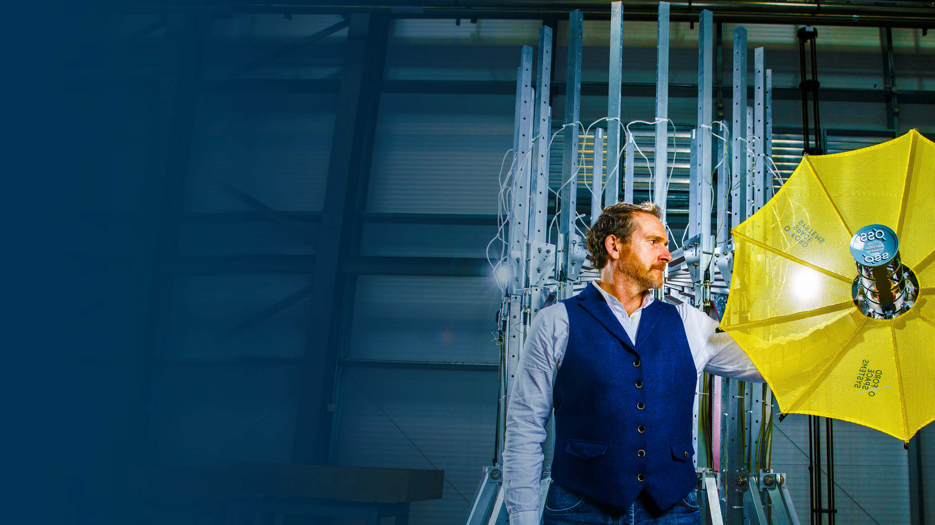

Innovate UK
We are the UK’s innovation agency
We connect businesses to the people that can help them and fund businesses and research collaborations in all economic sectors, value chains and UK regions to accelerate innovation
Notes:
Innovate UK drives productivity and economic growth by supporting businesses to develop and realise the potential of new ideas.
We connect businesses to the partners, customers and investors that can help them turn ideas into commercially successful products and services and business growth.
We fund business and research collaborations to accelerate innovation and drive business investment into R&D. Our support is available to businesses across all economic sectors, value chains and UK regions.

Slide 3
Innovate UK’s response to COVID-19
Supporting the immediate response
Ventilator challenge
Vaccine manufacture
Testing
Therapeutics
UKRI open call
Support for the innovation ecosystem
£20m de minimus call (closed 27/4)
£750m announced 20 April
  £200m b/f
  £300m continuity loans/grants
  £211m support for 1200 companies @£175k
EEN extra business support for 6000 companies to March 2022

Slide 4
Otherwise business as usual; ISCF, SMART… (though we have delayed some competitions and extended some deadlines)

Slide 5








ISCF: investing in challenge-led programmes
Ageing society
AI and Data
Economy
Future of mobility
Clean growth
Prospering from Energy revolution
Transforming construction
Transforming food production
Manufacturing made smarter
Smart sustainable plastic packaging
Industrial decarbonisation
Transforming foundation industries
Low cost nuclear
Faraday battery challenge
Self driving vehicles
National satellite test facility
Robotics for a safer world
Future flight
Driving the electric revolution
Medicines manufacturing
Data to early diagnosis
and precision medicine
Healthy ageing
Accelerating detection of disease
Audience of the future
Next generation services
Commercialising quantum technologies
Digital security by design
Notes:
We are also taking a challenge- led investment approach.
We are investing in the key challenges our economy and society is facing, as set out in the Industrial Strategy.
We are working with partners across industry and academia to develop solutions which will boost the economy, create high-value jobs and enhance society.

Slide 6

Innovate UK Smart funding
For businesses in any sector
enables businesses to apply for grant funding regardless of technical or industrial area of focus
funding for the best proposals in a competitive application process
‘Always open’ competitions offering a total of £100 million funding. Latest round closes 27 May.
Paul Holt, founder, Photocentric
Notes:
We always aim to provide the best service and support, at the best level of service, to our valued clients. In order to do so, please can all enquiries go through our fully trained and resourced customer support team, who will acknowledge directly and log the call or email, and ensure a response is provided either immediately or within a few days where the questions are more involved.

Slide 7
Some tips and tricks
Use the Knowledge Transfer Network (KTN) and other fora, to help build your network and connections
Sign up to here more information about Innovate UK opportunities
Check out international partnering and business support offered by EEN
Challenges and competitions often look for different perspectives and new approaches
Think about what you and your partners can do to address the scope and challenge
Consider how this can help connect you with future suppliers and customers
The time the call closes can vary so check the exact time and remember BST vs GMT!

Slide 8





@InnovateUK
Innovate UK
Innovate UK

Slide 9

Place unlocks innovation
Innovate UK funding supports businesses working across the UK.
Government R&D strategy in preparation
Scotland Bob Martin
North East,
Yorkshire & Humber
Lee Viney
Northern Ireland
Lorraine Acheson
North West
Rick Holland
East Midlands
Julian Bowrey
West Midlands
Ewa Bloch
Wales
Jon Wood
East of England
Howard Partridge
South West
Matt Silver
South East
David Legg

Slide 10


Knowledge Transfer
Network (KTN)
Find markets
Find solutions
Find funding
KTN is a network partner of Innovate UK. It helps businesses get the best out of creativity, ideas and the latest discoveries to strengthen the UK economy and improve people’s lives.
KTN links new ideas and opportunities from all sectors with expertise, markets and finance through a network of businesses, universities, funders and investors.
KTN supported clean-tech company FeTu

Slide 11
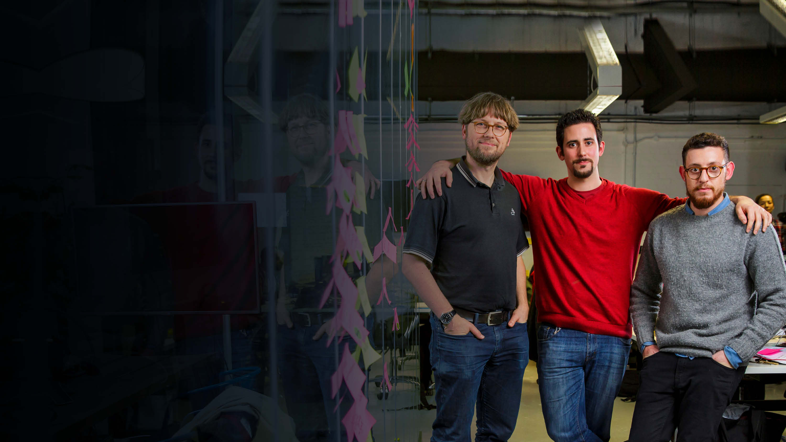
Knowledge Transfer Partnerships
(KTP)
KTPs help UK businesses innovate and grow by linking them with an academic or research organisation and a graduate
a KTP enables a business to bring in new skills and academic thinking
the academic or research organisation partner will help to recruit a suitable graduate
schemes last between 12 and 36 months
KTP partners Professor Udo Kruschwitz, Dr Miguel Martinez-Alvarez and David Benigson

Slide 12


Enterprise Europe Network
For growing, innovative businesses
Enterprise Europe Network is part of Innovate UK’s connecting network. It helps growing businesses to:
manage innovation, commercialise great
ideas and grow
access long-term finance from the public
and private sectors
connect to a network of advisors spanning
more than 60 countries
connect to partners to develop products
or services
expand into new countries with help
from local experts
Notes:
To connect with people we work with the EEN
In the West Midlands the EEN contract is delivered by two organisations – Coventry University Enterprises and Birmingham Chamber of Commerce.

Slide 13
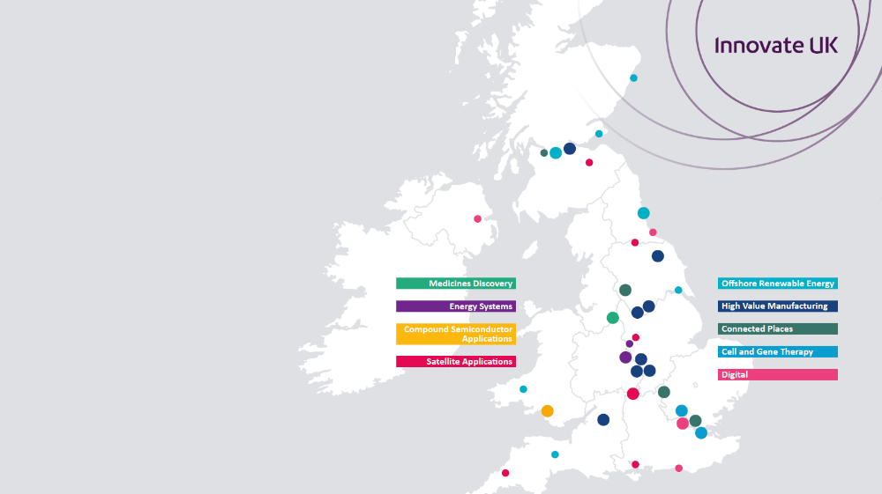
Catapult Network
Fostering innovation to drive economic growth
bridge the gap between businesses, academia, research and government
transforming the UK’s ability to create new products and services
ensure global opportunities for the UK and sustained economic growth for the future
Notes:
Easy access to HVM catapult centres in Sheffield and Coventry, plus Nuclear AMRC this year opened a new office on Infinity park, Derby
Connected Places Catapult centre in Milton Keynes

