Slide 1
Adapting your Supply Chains during a Pandemic
Presented by Adrian Waters
Manufacturing Growth Manager
South East Midlands Region

Slide 2
Supply Chains under Spotlight
Supply Chains generally quite flexible – however convoluted and complex
But this was unprecedented - No-one was or could be prepared for Covid-19
Recent survey by the Institute for Supply Management (ISM) found 75% disrupted by the crisis
More worryingly – 44% had no sort of plan to deal with the crisis yet (30th April)
As the crisis deepens – our own findings are that:
  Some are experiencing unprecedented demand – are hard pressed to meet from supply chain
  Others are decimated – no orders and/or immobile downward supply chain
  Most, however, are caught in between these two extremes
Companies who develop target-orientated actions plans – and execute when the time is right…
…may cope better and be in a stronger position to survive and perhaps emerge stronger

Slide 3
Adjusting Operations to Cope
Spoken with 144 companies in last six weeks following crisis
Takes the form of a Crisis Action Report – assesses key pain points and drives prioritization
Supply Chain feedback is that companies need to focus on two things in times like these
Tightening the connection between supply and demand – whatever your size
Understanding what inventory is critical to you, your suppliers - and your customers
Having a solid understanding of what customer priorities are is vital – and what they forecast
Strongest supply chains are those that operate dynamically based on real information and data
Data derived and gathered at both a state, local and customer level to meet shifting demand
For larger manufacturers
  will be a need for investment in automation and intelligent workflows based on this data
  smaller manufacturers will need to better integrate their forecasting and liaison with customer base

Slide 4
A Cycle of Risk Analysis and
Tactical Response in Operations
The Cycle of Risk has to deal with:
  The Supply Shocks – disruption in availability of goods
  The Demand Shocks – panic buying certain goods
  The After Shocks – will demand return to normal or waves of buying?
  The New Normal – beware the inventory bounce
  The Supply Chain Shrinkage – companies look to localise sourcing
Create a planning framework to break down/prioritise activities
Seek outside help if required – MGP Grant Support available
Break down cycle of risk in to daily, weekly, monthly plan in simple spreadsheet – containing tactical responses

Slide 5
Crisis Action Report Framework
MGP assists with conduct of Crisis Action Reports with SMEs
Feedback to date broadly correlates with national ISM survey
Provides a crisis monitoring tool to review:
  Your own business supply shock
  Your own business demand shock
  Your own plan and forecast for return to work
  Your own new normal and that foreseen by your customer base
  Your own plan to minimise future shocks to your supply chain

Slide 6
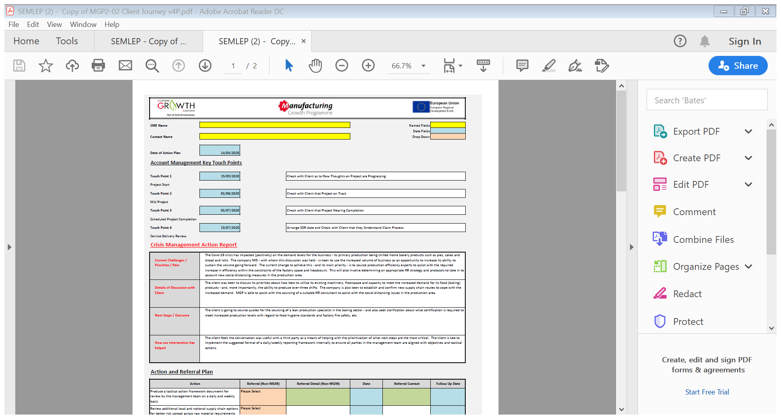
Crisis Action Report Template

Slide 7
Grant Support
MGP operating remotely – otherwise grant support as normal
To support the engagement of third-party support during crisis
33% support for Revenue projects against £3,000 to £6,000 spend
33% support for Cap-ex projects against up to £25,000 spend
Diagnostic takes place remotely i/o face-to-face
On-line assessment process (Growth Mapper)
Single supplier requirement
Up to four months in which to claim

Slide 8
Contact Details
Adrian Waters
Growth Manager
MGP – South East Midlands Region
adrian.waters@egs.live
07790 358557

