Slide 1
Revising your product portfolio and target markets in light of Brexit, COVID and changing business models
LiNDA Beal
SEMLEP Webinar March 2021

Slide 2
Key topics to cover
Ensuring you have accurate data on the performance of your products/services
Assessing if your existing cost, price and volume projections are realistic
Understanding your value proposition
Assessing how much you know about your competition and overall market
Understanding what is needed to explore potential investment opportunities
Being confident in making business decisions

Slide 3
1. Ensuring you have accurate data on the performance of your products/services
Do you know which are making money, which are not, and why
There are different complexities for software, services, hardware
Need to report correctly and consistently, particularly if you have a range of products or services
Need to understand/agree the cost allocation
Need to understand the importance of each product/service to the business
Need to review performance against projections
Need accountability/ownership for performance

Slide 4



Actual case studies
  Assessing if a business unit providing an on-site advisory service was making money
  Trying to understand comparative costings for a survey and analysis service
  Determining the actual profitability of an insurance product

Slide 5
1. Ensuring you have accurate data on the performance of your products/services
Do you know which are making money, which are not, and why
There are different complexities for software, services, hardware
Need to report correctly and consistently, particularly if you have a range of products or services
Need to understand/agree the cost allocation
Need to understand the importance of each product/service to the business
Need to review performance against projections
Need accountability/ownership for performance

Slide 6
2. Assessing if your existing cost, price and volume projections are still realistic
  Are there any short or long term changes in the market due to COVID or Brexit?
  Has there been any change in the base demand, or sales channel, or rise in costs, or other changes?
  Take each product or service, each market, a sample of customers, and assess
  Establish any changes in volume, mix, pricing, costs, forecasts going forward
  Input the new figures into the business plan/financials - produce sensitivity models

Slide 7
2. Assessing if your existing cost, price and volume projections are still realistic
  Why is this important?
  Your business model will be set up assuming such, operating costs, loans, staffing, stock
  Your business plan and strategy will be based on such
  Your success is based on having accurate, realistic data, reforecasting when that data changes
  Business plans are living documents and need to be revised (ideally quarterly)
  Gaps/shortfalls need to be addressed; what can be done to reduce the risk and what is the impact on the business of doing nothing

Slide 8
2. Assessing if your existing cost, price and volume projections are still realistic
  Why is this important?
  Your business model will be set up assuming such, operating costs, loans, staffing, stock
  Your business plan and strategy will be based on such
  Your success is based on having accurate, realistic data, reforecasting when that data changes
  Business plans are living documents and need to be revised (ideally quarterly)
  Gaps/shortfalls need to be addressed; what can be done to reduce the risk and what is the impact on the business of doing nothing

Slide 9
3. Understanding your value proposition, competitive advantages, feedback from customers
  Do you know what your customers think of your products?
  How do your products help their business; what value they put on them, what additional products may help them grow, their satisfaction with your overall products and service, their loyalty to your brand/company?
  Can you sell more of your existing portfolio to your existing customers?
  Insights of any level are important – gives information on the landscape, satisfaction with your business/service/products

Slide 10
3. Understanding your value proposition, competitive advantages, feedback from customers
  Do you know what your customers think of your products?
  How do your products help their business; what value they put on them, what additional products may help them grow, their satisfaction with your overall products and service, their loyalty to your brand/company?
  Can you sell more of your existing portfolio to your existing customers?
  Insights of any level are important – gives information on the landscape, satisfaction with your business/service/products

Slide 11
4. Checking how much you know about your competition, new technologies, new products, new markets
  What data do you have on potential new products/services, competitors, customer groups, markets?
  Do you put time aside to investigate such or just log customer/sales requests?
  Are you regularly assessing potential product or market growth/investment options?
  Is that a part of your vision or strategy?
  If not why not - no time, no resource, no appetite, a focus on maintaining business or consolidation due to COVID, dealing with Brexit?
  In periods of extreme change it is important to review the market – even if only to understand potential risks/opportunities

Slide 12
4. Checking how much you know about your competition, new technologies, new products, new markets
  What data do you have on potential new products/services, competitors, customer groups, markets?
  Do you put time aside to investigate such or just log customer/sales requests?
  Are you regularly assessing potential product or market growth/investment options?
  Is that a part of your vision or strategy?
  If not why not - no time, no resource, no appetite, a focus on maintaining business or consolidation due to COVID, dealing with Brexit?
  In periods of extreme change it is important to review the market – even if only to understand potential risks/opportunities

Slide 13
5. Understanding what is needed to explore potential investment opportunities
  Allow adequate time to investigate
  Put aside necessary funds (market research, market testing, specialist experts if needed)
  Have a disciplined, interested team
  Build a basic financial model to determine ROI and identify the key levers for success
  Look at all costs; development, resource, marketing, maintenance, impact on capital
  Look at the operational impact, implementation plan
  Assess the business appetite, business distraction element
  Pull together realistic risks, be honest
  The more detail and accurate data to support the business case the better

Slide 14
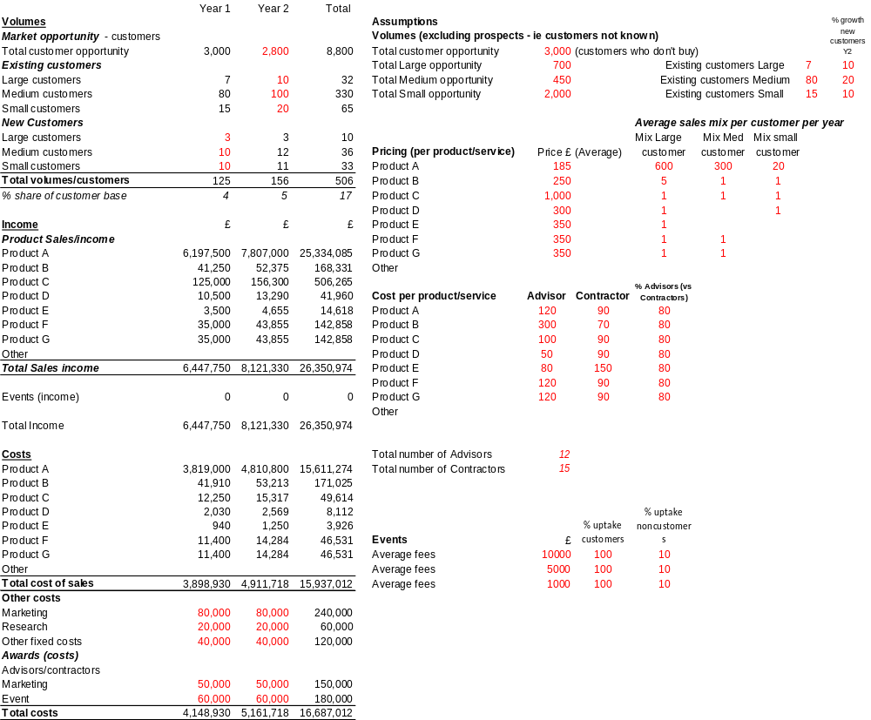
Actual case study
The importance of robust financials within the business case

Slide 15
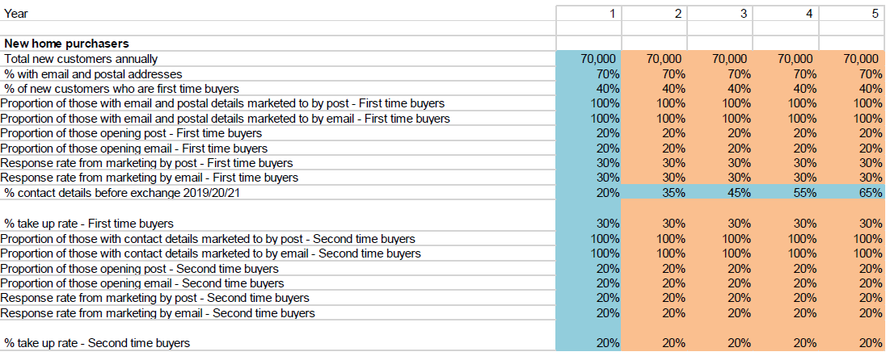
Actual case study
The importance of assumptions to support the financials

Slide 16
5. Understanding what is needed to explore potential investment opportunities
  Allow adequate time to investigate
  Put aside necessary funds (market research, market testing, specialist experts if needed)
  Have a disciplined, interested team
  Build a basic financial model to determine ROI and identify the key levers for success
  Look at all costs; development, resource, marketing, maintenance, impact on capital
  Look at the operational impact, implementation plan
  Assess the business appetite, business distraction element
  Pull together realistic risks, be honest
  The more detail and accurate data to support the business case the better

Slide 17
6. Being confident in making business decisions
Instil the right culture; drive accurate, relevant, robust data
Assess and compare different investment options against each other
Use business cases to determine the success or otherwise of projects/investment opportunities
Know what questions to ask; use a consistent approach when reviewing options, challenge any gaps
Demand good financials for each project, with risks and sensitivity models (best case/worst case scenarios)
Prioritise; check you are spending your money in the most effective way
Track and monitor progress of all projects/investments, including previous failures to better understand likely pitfalls and business limitations

Slide 18


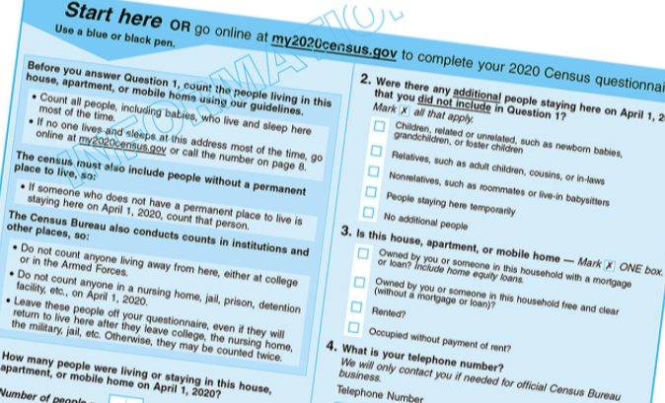
Actual case study
  Assessing if there was a business case for introduction of a unique GPS device as part of an international Census solution

Slide 19
6. Being confident in making business decisions
Instil the right culture; drive accurate, relevant, robust data
Assess and compare different investment options against each other
Use business cases to determine the success or otherwise of projects/investment opportunities
Know what questions to ask; use a consistent approach when reviewing options, challenge any gaps
Demand good financials for each project, with risks and sensitivity models (best case/worst case scenarios)
Prioritise; check you are spending your money in the most effective way
Track and monitor progress of all projects/investments, including previous failures to better understand likely pitfalls and business limitations

Slide 20
Any Questions
LiNDA Beal
SEMLEP Webinar March 2021

