Slide 1

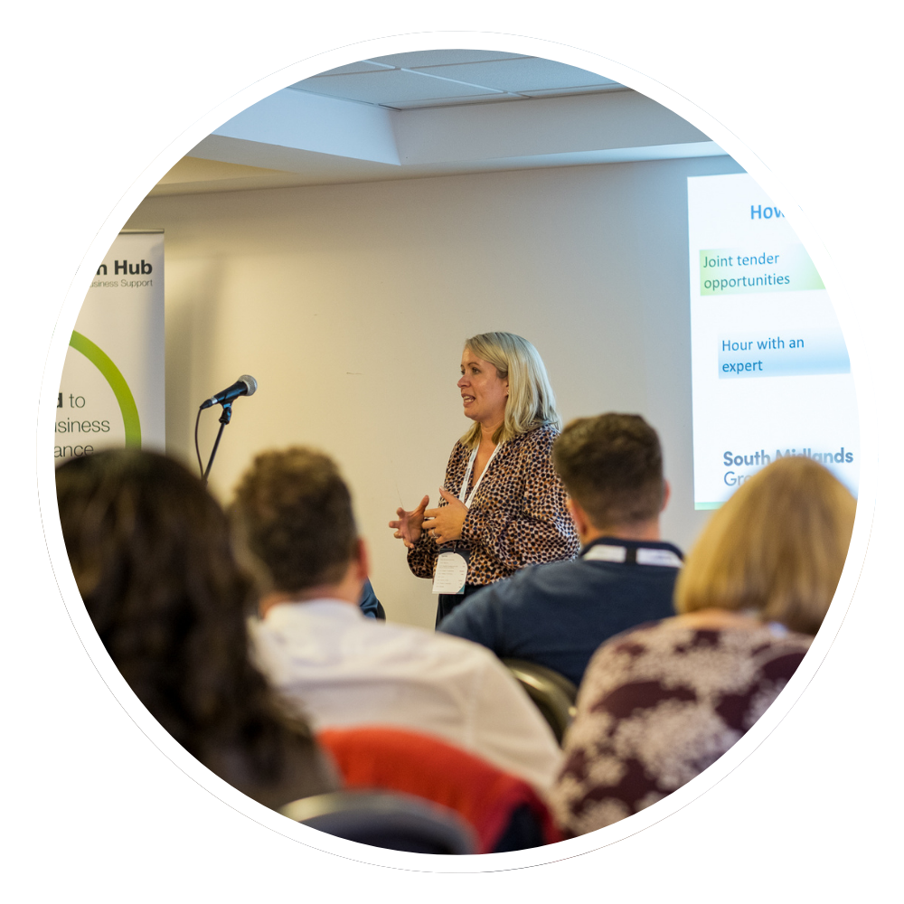
Growth Hub Board
9 June 2025
Ruth Roan, Growth Hub Manager

Slide 2
‘The Growth Hub serves as a vital resource for businesses in the South Midlands region, offering a wide range of services aimed at facilitating growth and sustainability. Our multifunctional approach caters to the diverse needs of businesses, whether they are start-ups or established enterprises and regardless of sector. Our main priority is to drive economic growth across The South Midlands.’
Aim Provide free, comprehensive business advice and support to businesses across the region.
Vision
To be a trusted resource for businesses and partners fostering innovation, sustainability, and economic growth across the South Midlands.
Objectives
1. Support economic development in the South Midlands.
2. Enhance business capabilities through resources, funding, specialist support and market intelligence through partnership working across the region.
3.Showcase the region as a premier destination for businesses.

Slide 3
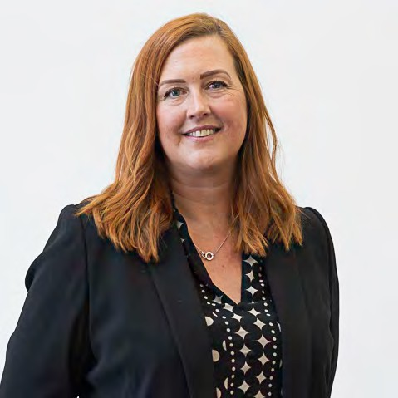
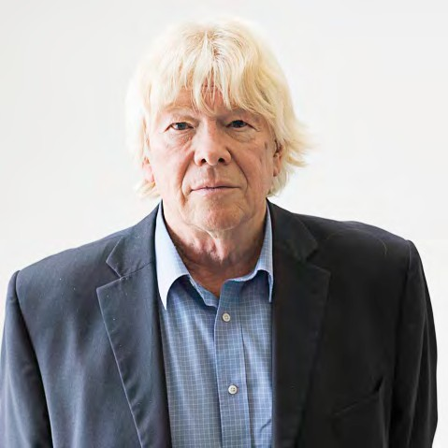
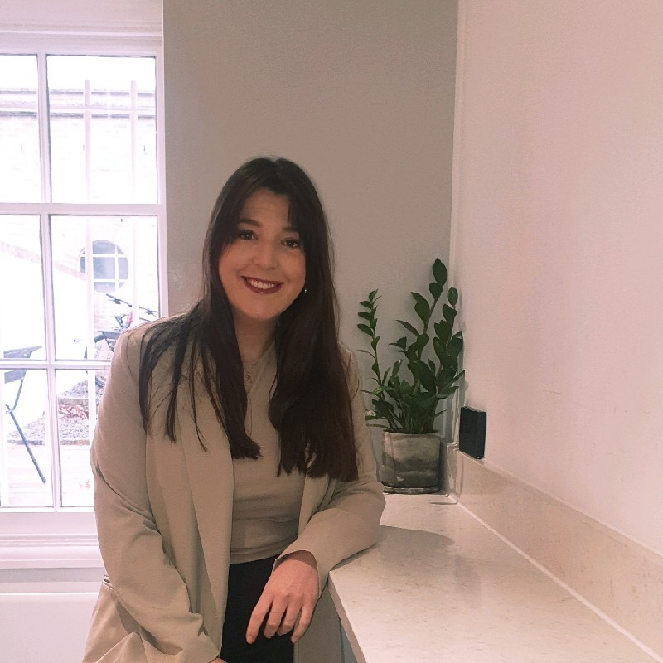
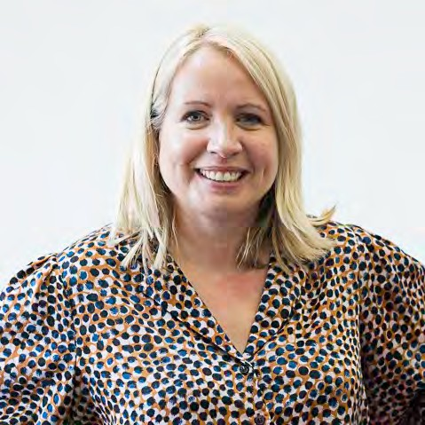
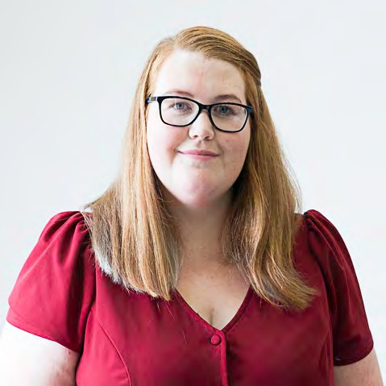

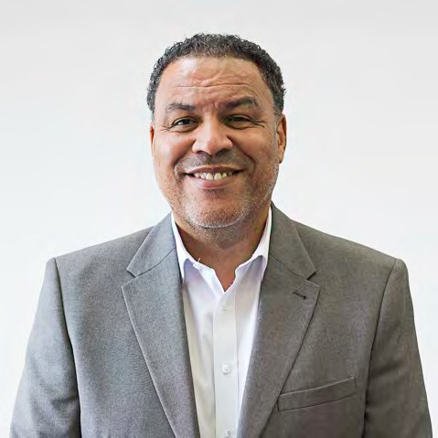
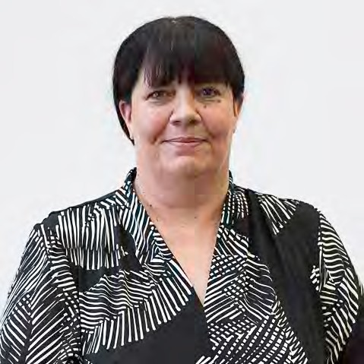
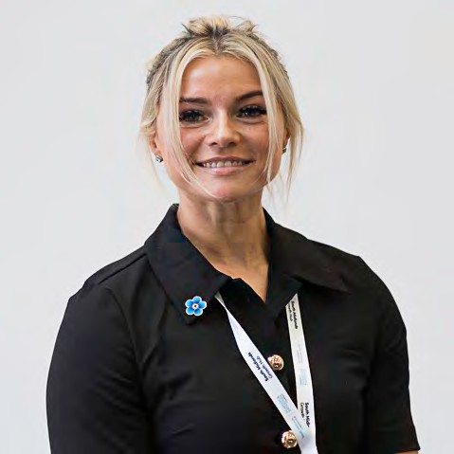
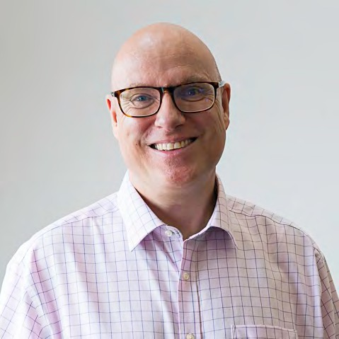
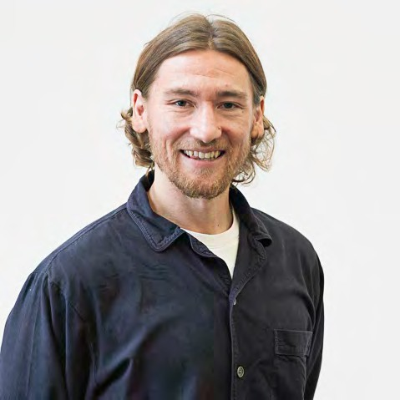
SM Growth Hub Team
GH Business Support Team
Looking to the future
GH Strategic Support Team
Kelly Griffiths Business Advisor Team Lead (MK specialist)
Neil Smith
Business Advisor (West Northants Specialist)
Jess Stead
Business Advisor (Bedfordshire Specialist)
Ruth Roan
Growth Hub Manager
Emma Panter
Senior Administrator
Vacancy
Project Support Officer
Carl Mayers
Business & Commercial Enterprise Manager (North Northants specialist)
Allison Coleman Senior Grants Executive
Samantha Hunter
Partnership & Events Manager
Mark Horder
Project Manager
Patrick Kitson
Marketing Lead

Slide 4






Businesses Supported in the South Midlands by the Growth Hub – 2024/25
1750+ business support enquiries
4300+ hours of support provided
48 Hour with an Expert sessions
543 businesses attending across 21 events
780 referrals to relevant specialist for support
80 Grants Awarded

Slide 5
2024/25 South Midlands Outputs
 | South Midlands KPI | South Midlands Total | Variance
Total number of enquiries received | 1,500 | 1750 | 117%
Light intensity support (<1 hour) | 800 | 780 | 98%
Medium intensity support (1-12 hours) | 550 | 715 | 130%
High intensity support (12+ hours) | 50 | 99 | 198%
Workshop / Event attendees | 300 | 542 | 180%
Workshops/ Events | 25 | 21 | 84%
Referrals to external support | 600 | 780 | 130%

Slide 6

2024/25 Local Authority Activity
 | Bedford Borough 10% | Central Beds 17% | Luton 11% | Milton Keynes 17% | North Northants 20% | West Northants 25%
Enquiries | 150 | 176 | 77 | 397 | 257 | 398
Hours of Support | 340+ | 450+ | 110+ | 1150+ | 700 | 1100+
Event Attendances | 54 | 61 | 12 | 97 | 109 | 118
Referrals | 41 | 47 | 21 | 85 | 72 | 183
Projects | Step into Net Zero | N/A | N/A | Bletchley & F.Stratford Grant Scheme | Tourism together | -Business Support -InspireHer -Tourism together
Grants | 8 RIG 2 GIF | 9 RIG 4 GIF | 1 Rig 1 GIF | 7 RIG 2 GIF | N/A | 25 RIG 5 GIF

Slide 7
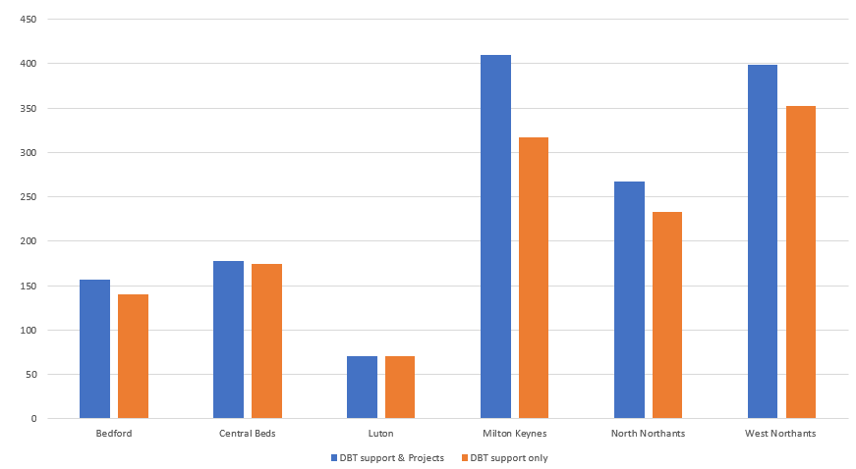
Enquiries by Local Authorities 2024/25

Slide 8
Enquiries by Type 2024/25
*SM Growth Hub to be broken up in 25/26 to better reflect activity

Slide 9
2024/25 Projects
Tourism Together – Northamptonshire
This initiative supported 40 tourism businesses, ranging from heritage sites to family attractions, helping them adapt to shifting visitor behaviours and market demands.
Outcomes:
Delivered four sector-specific workshops focused on innovation and market positioning.
Provided tailored consultancy to support operational improvements.
Culminated in a Tourism Excellence event to celebrate achievements and share best practices.
Contributed to a more collaborative and future-ready tourism sector across the region.
Step into Net Zero – Bedford
Supporting local businesses on their path to sustainability, providing practical tools, guidance, and funding advice to help companies reduce their environmental impact.
Outcomes:
Delivered 1:1 sustainability consultations and Carbon Reduction Workshops.
Supported businesses in applying for innovation and sustainability funding.
Enabled participants to make measurable progress toward Net Zero goals.
Reinforced the council’s commitment to a green and resilient local economy.
Bletchley and Fenny Stratford Grants – Milton Keynes Targeted grant programme aimed to strengthen the local economy by supporting both established and early-stage businesses in Bletchley and Fenny Stratford.
Outcomes:
Delivered 25 grants worth c.£120k
Provided one-to-one business support to address specific growth barriers.
Helped stimulate local economic activity and innovation within key neighbourhoods.
InspireHer Programme – West Northants
Focused on the empowerment of female-led businesses in West Northants, fostering inclusive economic growth by supporting women entrepreneurs at various stages of development.
Outcomes:
Delivered high quality coaching, specialist workshops, and peer to peer networking.
Enabled participants to develop Growth Action Plans aligned with strategic objectives.
Awarded micro grants to 4 university students to encourage the next generation of female founders.
Strengthened the entrepreneurial ecosystem for women across the region.
John Franklin – West Northants
Designed to nurture early-stage business growth across West Northants, equipping aspiring and new entrepreneurs with the tools, knowledge, and funding to build viable enterprises.
Outcomes:
Delivered hands-on workshops in business planning, finance, and marketing.
Provided tailored advice via one-to-one business consultations.
Issued 16 £1,000 start-up grants to support critical early investment.
Promoted long-term sustainability and resilience in the local start-up landscape.

Slide 10
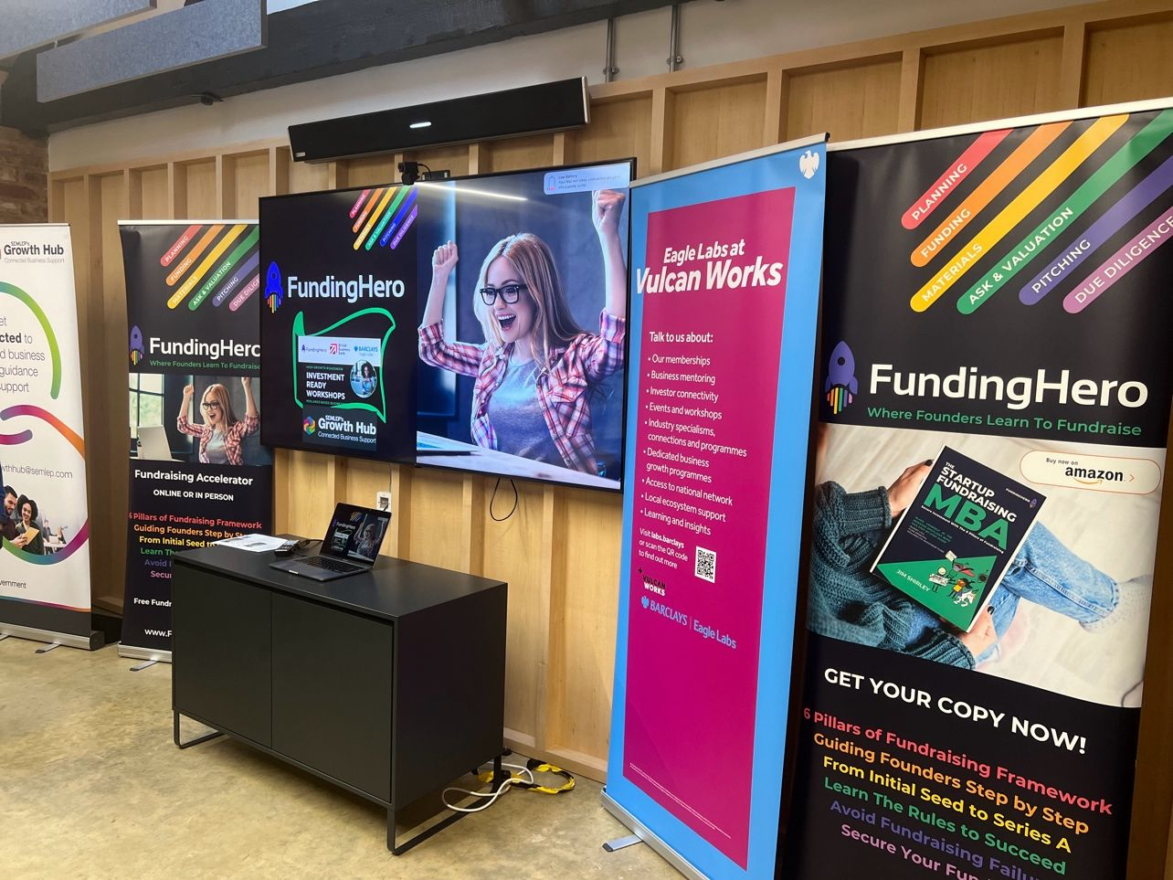
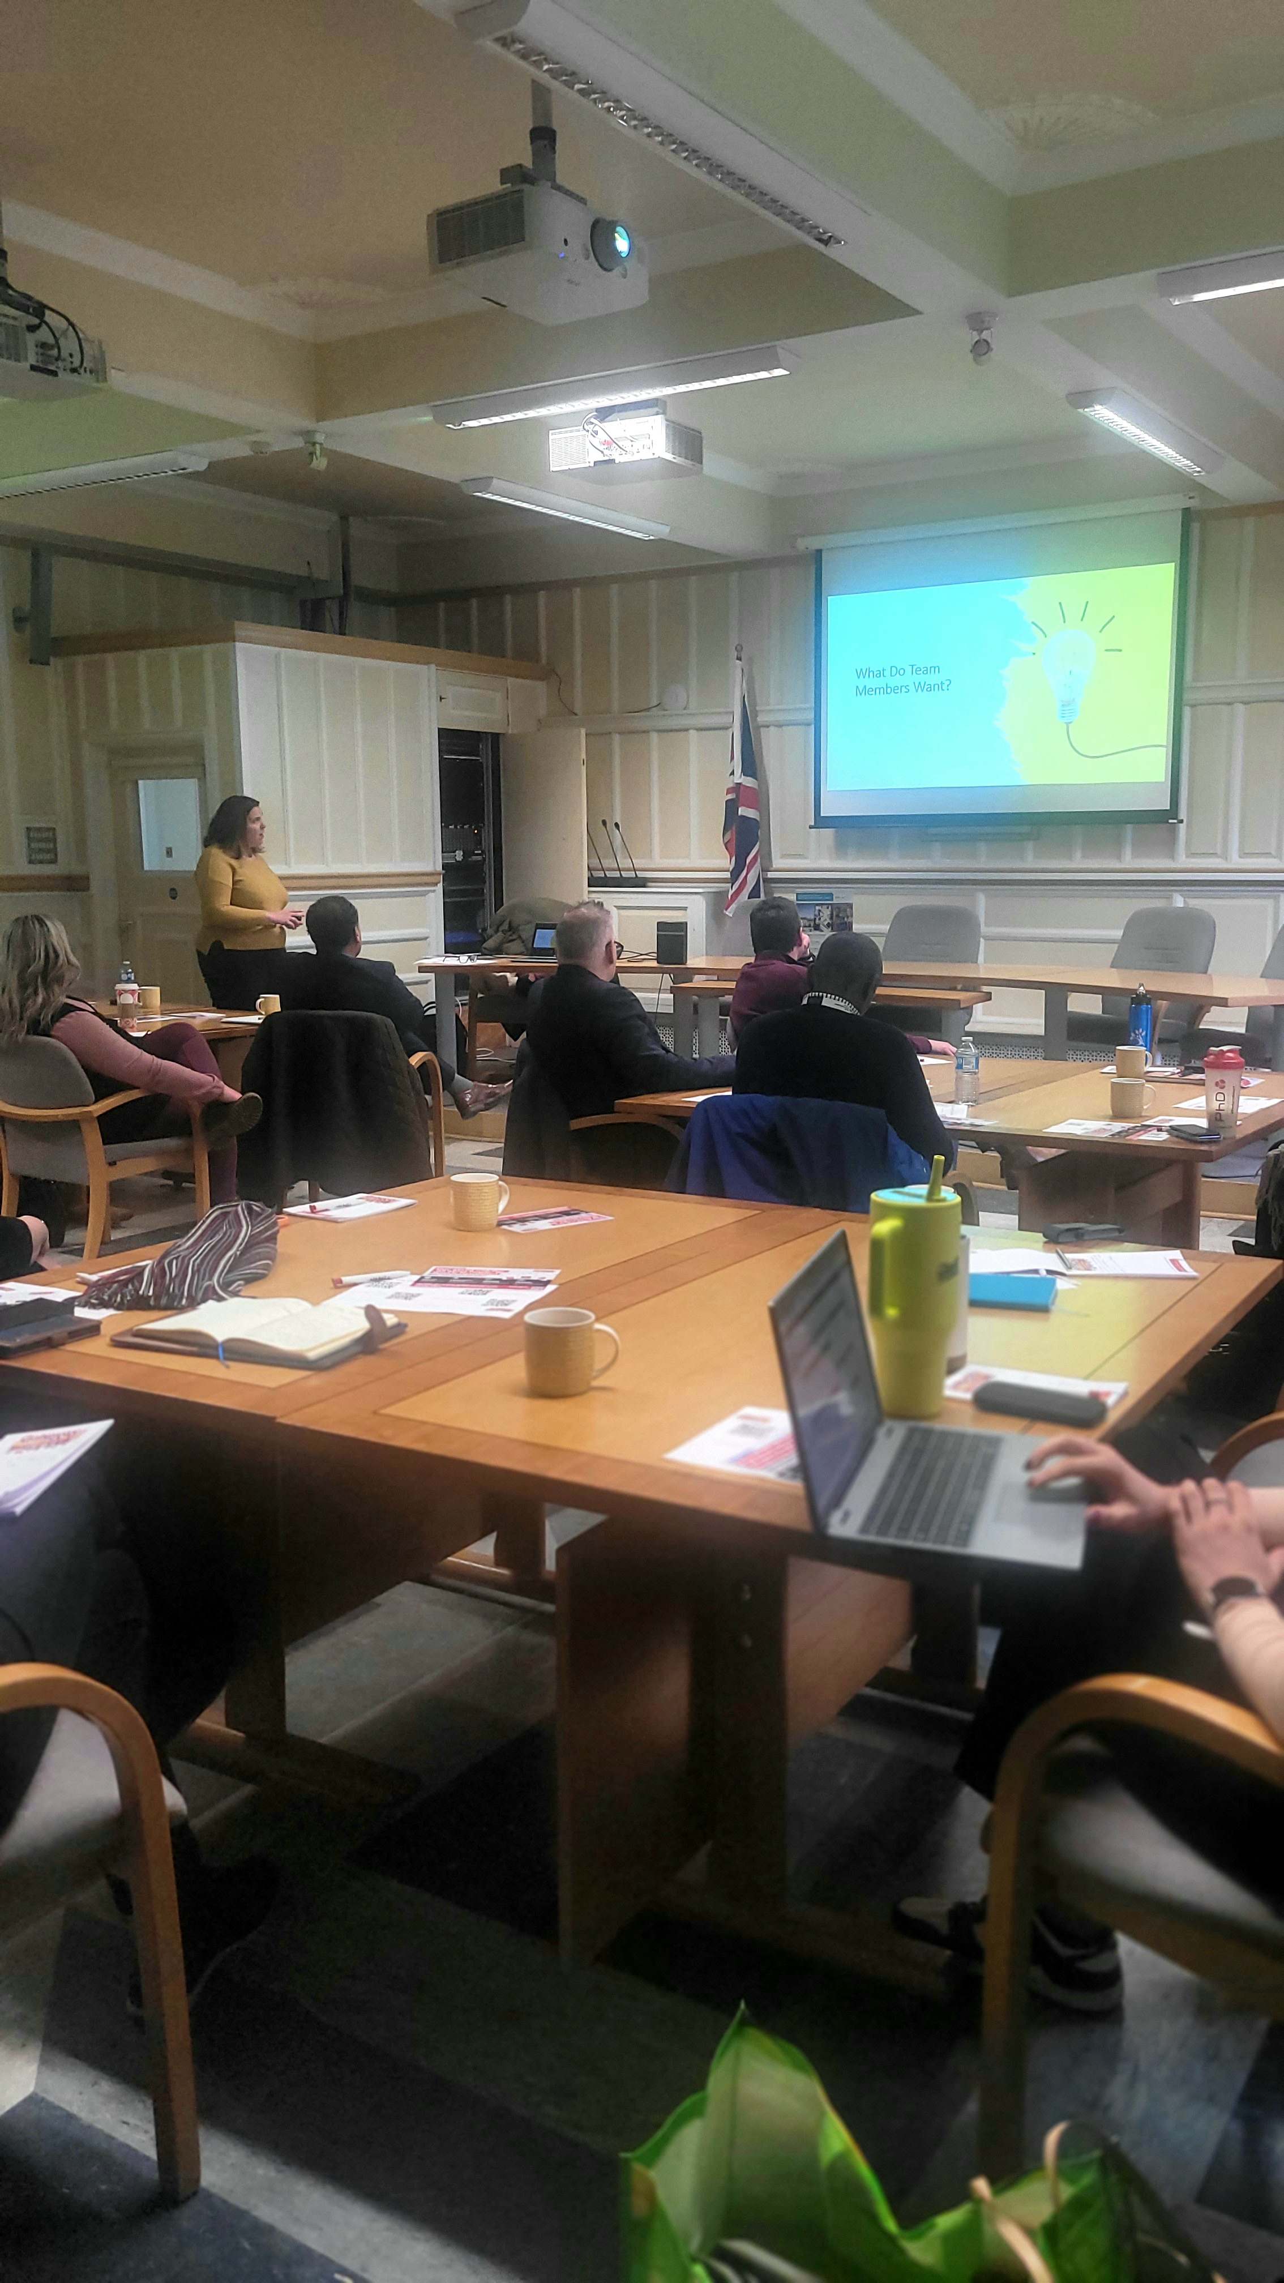
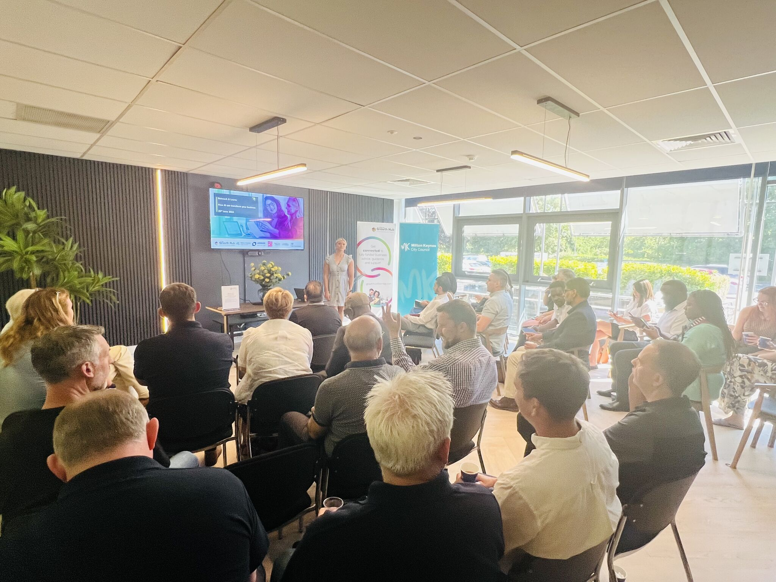
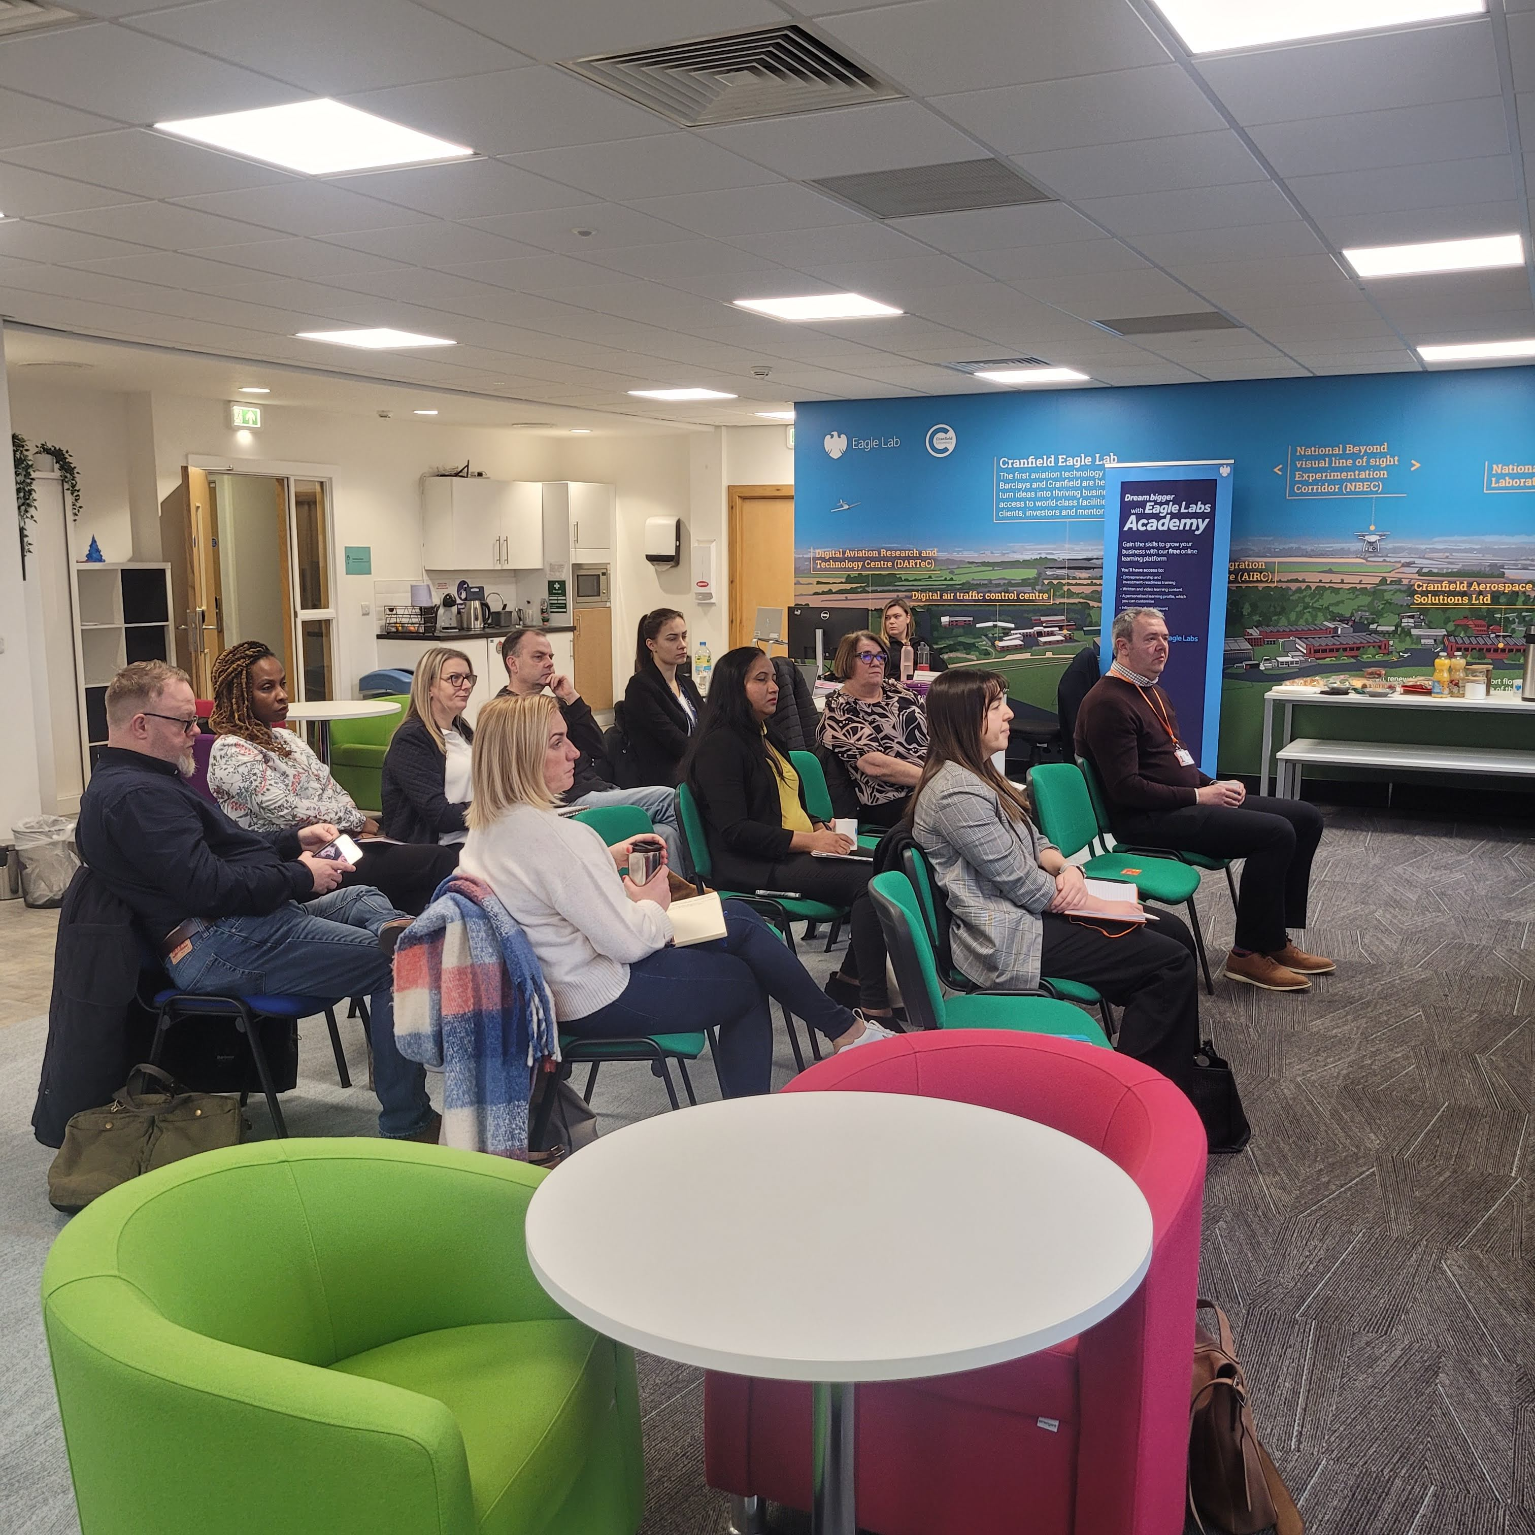
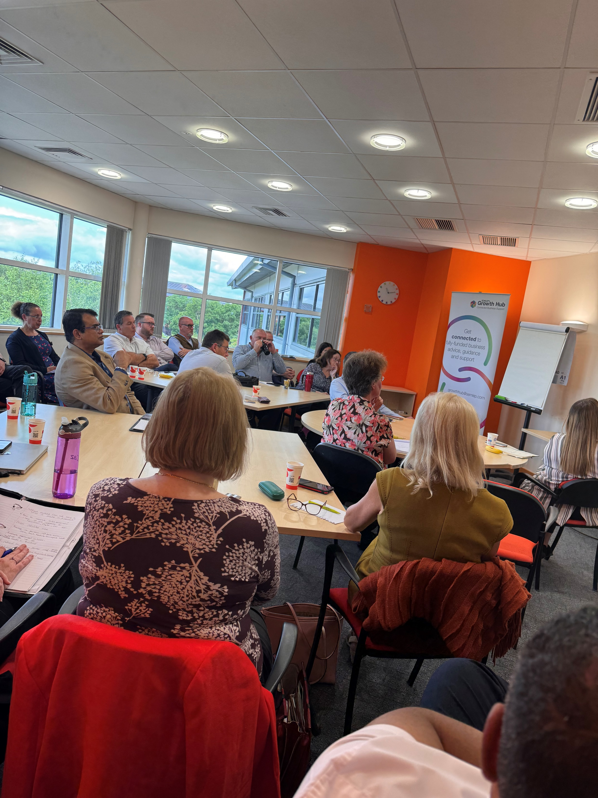
Events and Partnership 2024/25
Network and Learn - Always in partnership a Local Authority, in excess of 300 attendees supporting businesses with scaling up, sustainability, AI, HR, apprenticeships, sales.
Joint Growth Hub & Careers Hub Conference in September, 200+ attendees bringing together education & industry.
First BusinessFest conference supported by 20+ partners and over 80 businesses attending.
Moneyfest event in partnership with NatWest & British Business Bank. 80+ businesses being educated on funding opportunities and how to access the right funding for their business.
Partner events – Northants, MK & Beds Chambers, Pulse Media, FSB, UoB, UON, TC Group, MK College, UK Export.
Tourism Excellence Programme in Northamptonshire, conference with 120+ attendees & 15+ partners taking value from experts in the industry on sustainability, diversification, & upskilling the workforce. Additional 1:1’s with 40+ business owners.

Slide 11
Resilience and Innovation Grants
The Resilience and Innovation Grant provided support to enterprises based in the South Midlands area who were looking to invest in their business leading to:
Growth.
Strengthen their business performance and resilience to respond to cost of living challenges.
Increase innovative levels and enhance sustainability, in support for the transition towards a net zero economy.
Through this programme the Growth Hub has awarded £1,870,356M to 62 businesses across the region.
Local Authority | Nº Grants Awarded | Grants Awarded | Private sector match
Central Bedfordshire | 9 | £270,805.26 | £609,506.38
Luton | 1 | £34,503.50 | £36,306.79
North Northants | 12 | £364,383.37 | £446,689.41
West Northants | 25 | £733,833.75 | £1,102,082.58
Bedford | 8 | £229,422.20 | £298,213.99
Milton Keynes | 7 | £237,408.43 | £321,084.07
Total | 62 | £1,870,356.51 | £1,886,740.57

Slide 12




62 businesses supported
Innovation
46 New products to the business committed
29 New products to market committed
45 New process to the business committed
35 New Service to the business committed
16 New service to the market committed
Growth
144.80 Jobs committed
Sustainability
62 decarbonisation plans created

Slide 13
Growing Innovation Fund
The Growing Innovation Fund is designed to fuel business innovation by providing financial support to ambitious companies in the South East Midlands region. The Grants are for businesses looking to:
Strengthen innovation
Support decarbonisation
Assist with the commercialisation of ideas.
Through this grant programme, the Growth Hub has awarded £3,395,759 in matched funding to 18 businesses across the region.
Local Authority | Awarded | Grants Awarded | Private Sector Match
Bedford | 2 | £410,000.00 | £580,019.00
Central Bedfordshire | 4 | £898,777.00 | £1,175,965.00
Luton | 1 | £100,109.65 | £100,109.66
Milton Keynes | 2 | £416,250.42 | £417,070.42
North Northants | 4 | £695,005.00 | £792,054.00
West Northants | 5 | £875,254,98 | £1,002,265.31
Total | 18 | £3,395,397.05 | £4,067,483.39

Slide 14
18 businesses supported
Innovation
10 New products to the business committed
5 New products to market committed
14 New process to the business committed
11 New Service to the business committed
5 New service to the market committed
Growth
137.60 Jobs committed
19 jobs safeguarded
Sustainability
421,273.10 tonnes of Co2 saved

Slide 15
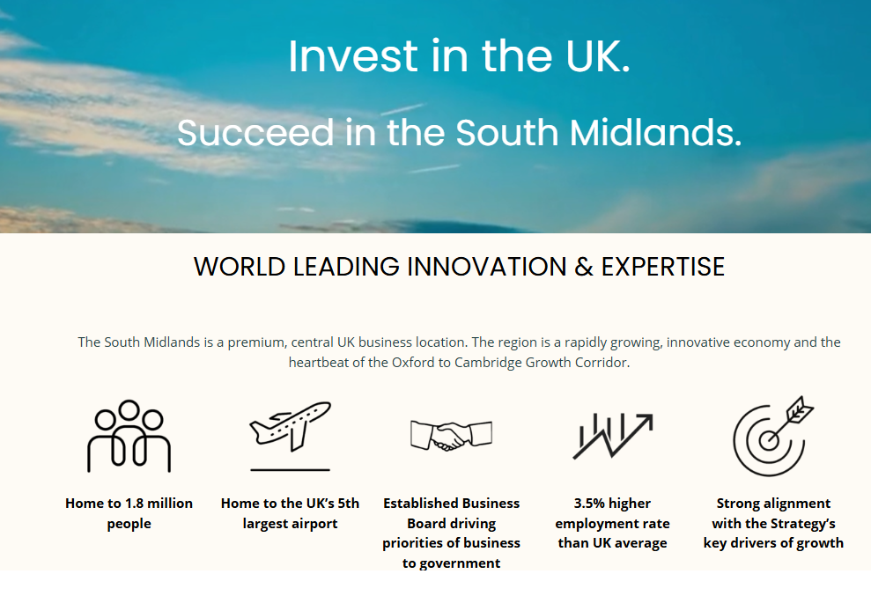
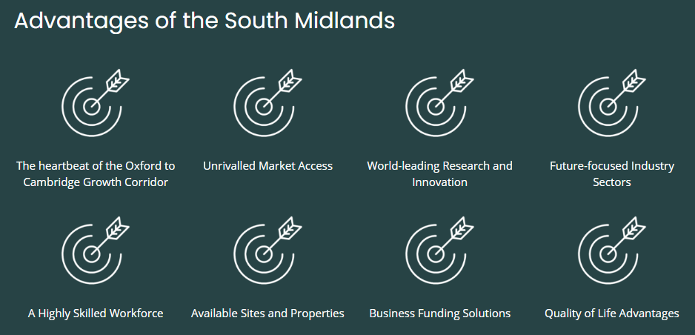
Inward Investment
Integrating inward investment into broader business support services, becoming part of the business-as-usual element of a BA’s role within a referral capacity.
Department for Business and Trade (DBT) directly engaging with LAs on requests but the Growth Hub will continue to take a supporting role referring, facilitating and promoting the South Midlands in place making.
Established a quarterly Inward Investment Forum to facilitate collaboration between DBT, GH, LAs, and other key stakeholders.
A dedicated Inward Investment landing page for the South Midlands on the South Midlands Authorities home page … coming soon.

Slide 16
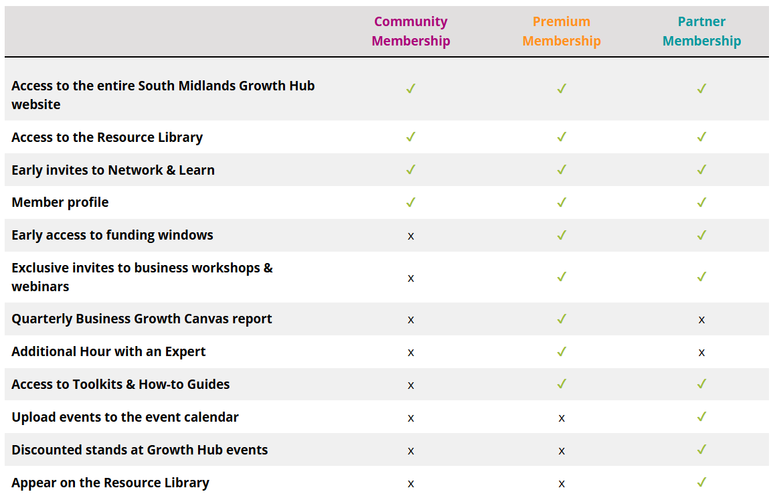
Communications
South Midlands Authorities website launched, including Business Board and Skills Hub
158,000 page views on GH website
More than 19,000 visitors to GH website
Sharing of partner promotional materials, events, toolkits
Membership to provide easy access to business guidance, business adviser support and collaboration with your peers.
Case studies on the website Case Studies | The Growth Hub
Events page - Business events | Growth Hub

Slide 17
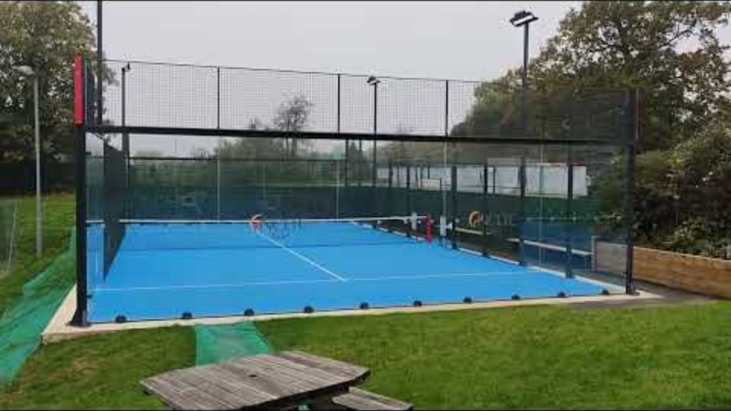
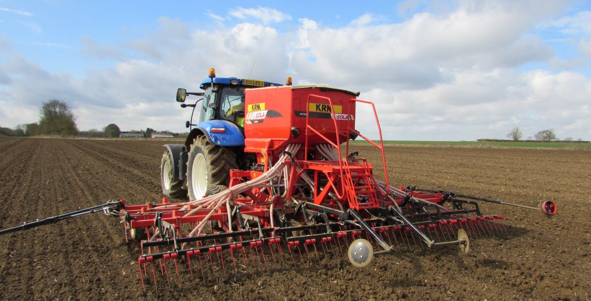
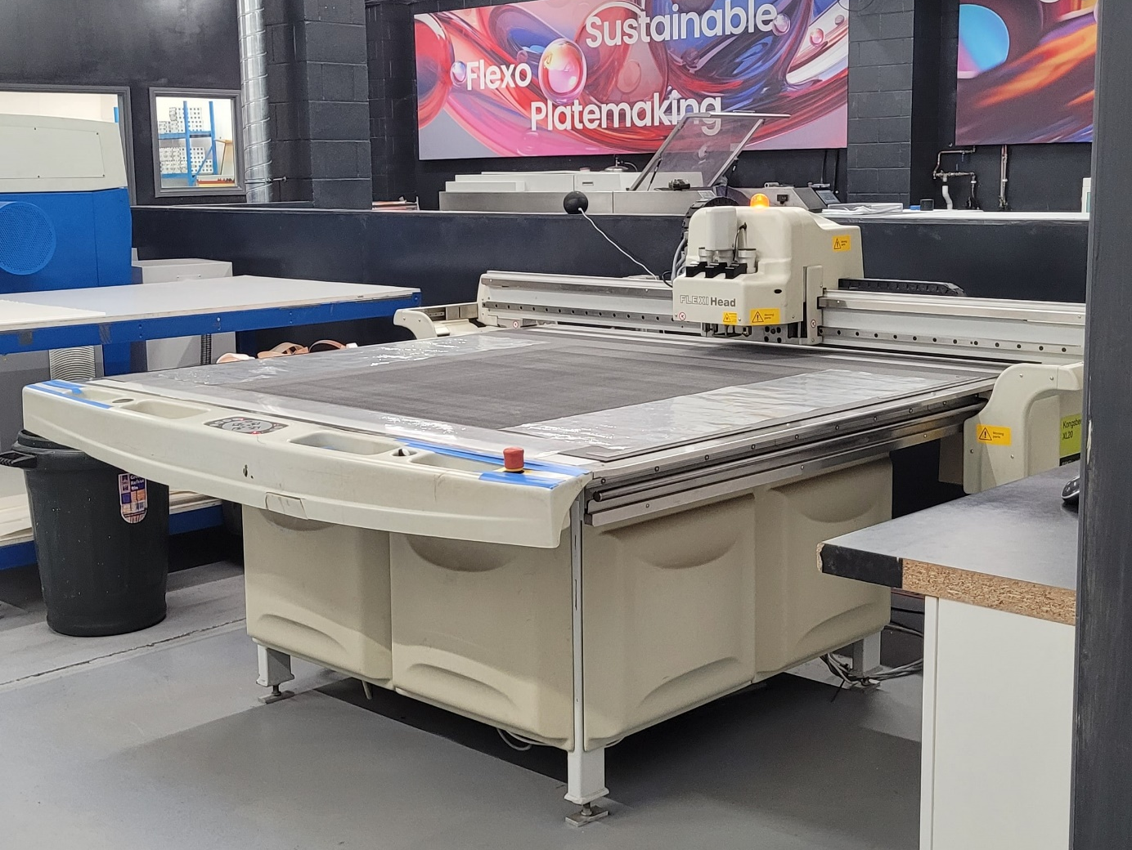
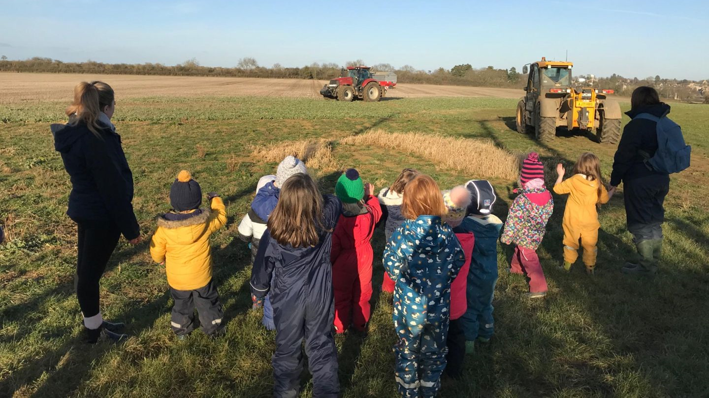
Case Studies / Testemonials
The investment we’ve been able to make through the Resilience and Innovation Fund has allowed us to position ourselves as a market disruptor, and cemented our existing relationship with Fuji Film, and most importantly, continue operating sustainably.
Passion for Print
“It’s really revitalised the club. We’ve welcomed 90 new members in the first three months alone, particularly in the 21-30 year category (an area we’ve been looking to increase).
“The Growth Hub was invaluable to putting is in the best position to be successful.”
Northampton County Lawn Tennis Club (NCLTC)
We're so glad we found this grant to apply for as it has made a huge difference to our business. The support and kindness from the team has been second to none, even when incorporating difficult changing parameters within our project and we are so grateful for this. It's lovely to deal with real people who clearly care.
Wormcount.com Ltd
I’m incredibly grateful to the Growth Hub for their support through a recent grant, which enabled me to attend a key networking conference and purchase essential equipment. The opportunity to connect with potential customers and industry peers has been invaluable, and I’m hopeful it will open up new doors for growth and collaboration. The support has made a real difference, and I truly appreciate the help in taking this next step forward.
Chris Pomfret Consultancy
Very helpful team, always ready to help and give the best advice. No question was too much to ask. Thank you for all support and help.
SweetAwe

Slide 18




Business support from the Growth Hub
Business advice & guidance
Grant programmes 2025/2026
Bespoke programmes
- Lord Lieutenant Mentoring Programme
1:1 business adviser support
‘Hour with an Expert’ series:
HR
AI
New for 2025/26
Rural
Sustainability
Digital Marketing
New partner grants launching soon.
Resources & Partner network
Connected 70+ trusted business support providers
Access to over 100 online business tools and resources
Net Zero Hub
Access to Net Zero programmes across the South Midlands
Networking & Events
Opportunity to engage with peers, partners, and industry experts through regular events
Inward Investment
Expert guidance on business expansion and relocation within region

Slide 19
Proposed 2025/26 Activity
 | South Midlands | Bedford Borough c10% | Central Beds c17% | Luton c11% | Milton Keynes c17% | North Northants c21% | West Northants c26%
Total number of enquiries received | 1,500 | 148 | 248 | 160 | 252 | 308 | 384
Light intensity support (<1 hour) | 800 | 79 | 132 | 85 | 135 | 164 | 205
Medium intensity support (1-12 hours) | 550 | 54 | 91 | 59 | 92 | 113 | 141
High intensity support (12+ hours) | 50 | 5 | 8 | 5 | 8 | 10 | 13
Workshop / Event attendees | 300 | 30 | 50 | 32 | 50 | 62 | 77
Workshops/ Events | 25 | 2 | 4 | 3 | 4 | 5 | 6
Referrals to external support | 600 | 59 | 99 | 64 | 101 | 123 | 153

Slide 20
2025/26 Activity
Core Business Support – 1:1 business advice, Hour with an Expert, online resource library.
3-year grant programme using unspent £1.3m LGF money.
Events programme – July Show me Success conference, new podcast, showcasing and supporting key partner events.
Partnership Engagement – Continuing strong partnership engagement with private and public sector partners.
Additional Projects and Income Generation
West Northants – Commitment of UKSPF for core delivery and local grants scheme.
Recent tenders include: NNC retail (unsuccessful), BBC & MKCC business support (awaiting response)
Exploring opportunities of private sector match
Inward investment – Continue to take a supporting role for Local Authorities for place making in the region.
Business Board – Naomi Butters as Lead representative, supporting the voice of business in regional decision making.
LSIP – Integrating into Growth Hub and Careers Hub activity.
Membership - Free, Premium, and Partner to provide easy access to business guidance, Business Adviser support and collaboration with your peers.
Website revamp – From Q2 with richer content including more tool kits and how to guides
Economic Growth Strategy – Aligning activity to Growth Strategy Action plan

