Slide 1

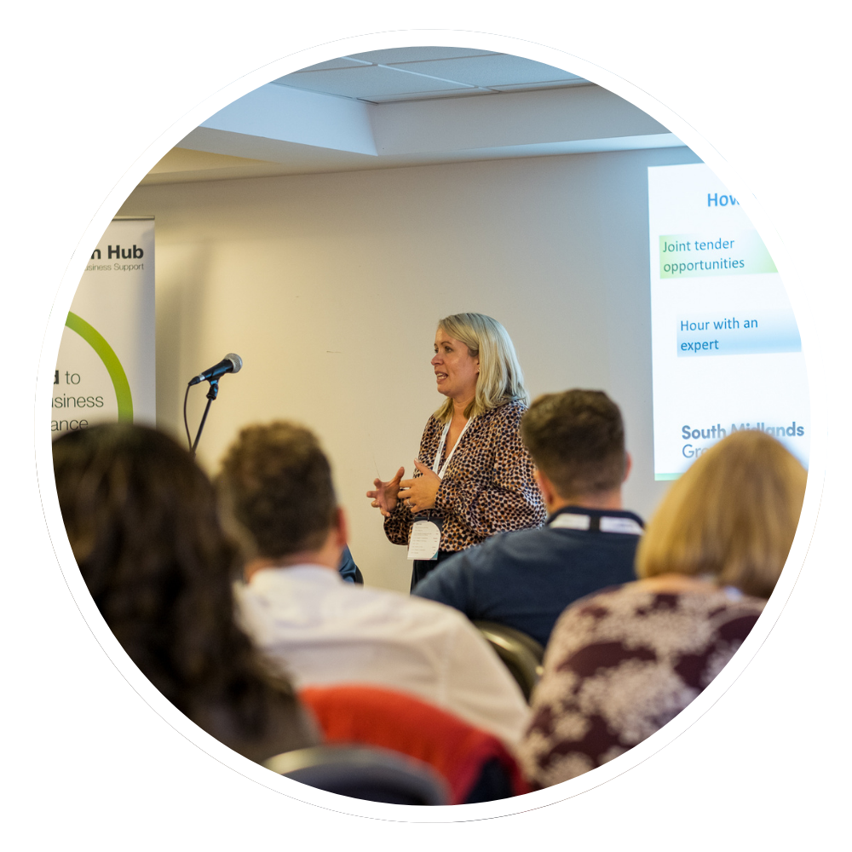
South Midlands Growth Hub Capital Grant Programme (2025–2028)

Slide 2
Proposal
Provide update on repurposing of Local Growth Fund (LGF) underspend
Propose new 3-year Capital Grant Programme
Seek board approval for:
Programme launch in Sept 2025
Use of £1.375 million LGF
Future reinvestment of any remaining RIG/GIF underspend

Slide 3
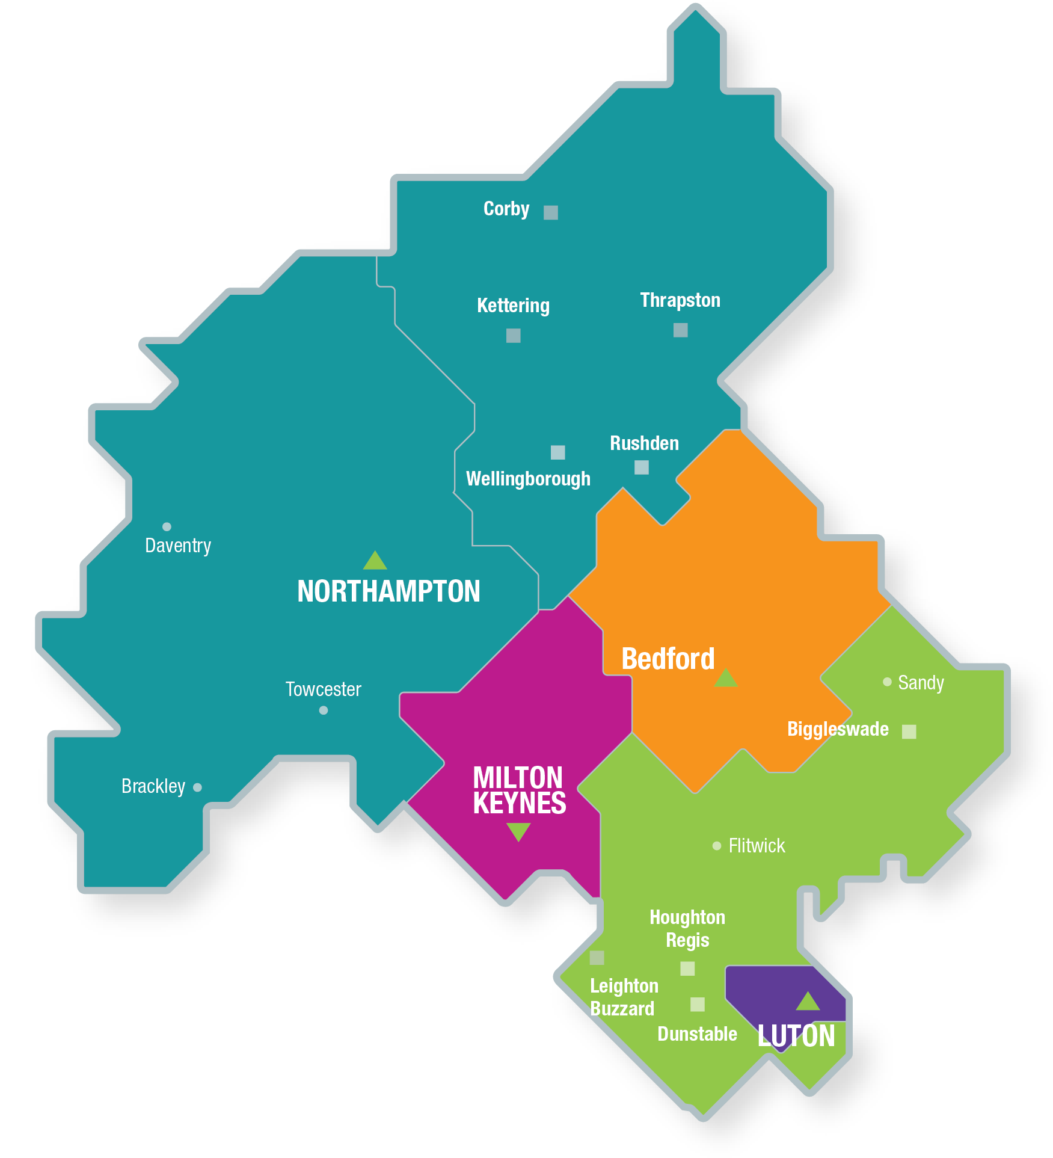
Background & Context
- LGF (2015–2021): £265m capital investment
- Resulted in 50+ successful projects
- £1.375m unspent due to Growpura Ltd insolvency
- Government permits repurposing under Growth Hub leadership

Slide 4
Lessons Learned from Past Programmes:
- More robust risk analysis required
- Deferred payments until delivery stages
- Frequent milestones & smaller tranches
- High-risk projects require tailored oversight

Slide 5
Programme Overview (2025–2028)
Launch: September 2025
Duration: 3 years (to August 2028)
Focus Areas:
- Clean Growth & Net Zero
- Innovation & Commercialisation
- Infrastructure & Place
- Business Scale-Up & Productivity
- Digitalisation & Smart Tech

Slide 6
Grant programme
Grant Scheme 1: Micro Capital Grant
Up to £3,000 grant (50% match)
Sole traders & microbusinesses
Supports equipment, digital tools, small innovation
Grant Scheme 2: Capital Growth Grant
£5,000 to £50,000 (50% match)
Established SMEs
Investments in plant, facilities, innovation infrastructure

Slide 7
Programme Delivery Structure
Total Budget: £1.375m (10% admin = £137,500)
Admin funds cover: Staff, due diligence, marketing
Grants awarded through competitive process
Clear assessment criteria: strategic fit, value for money, impact

Slide 8
Strategic Partnerships
Local Authority Economic Teams
South Midlands Business Board
Industry stakeholders
Programme Objectives
Address UKSPF uncertainty
Provide capital boost for innovation and sustainable growth
Target underserved sectors/geographies
Promote inclusive growth and accessibility

Slide 9
Next Steps
June-Sept 2025:
Evaluation of previous schemes
Scheme guidance finalised
Stakeholder consultation
Marketing & outreach
Launch: September 2025
First applications: 15 Sept 2025

Slide 10
Reallocation of Further Underspend
Potential RIG/GIF underspend may be added to the fund
Options:
Increase grant pot annually
Extend programme beyond 2028

Slide 11
Governance & Oversight:
Delivered by: South Midlands Growth Hub
Oversight: Business Board
Accountable Body: West Northants Council
Funder DBT: Quarterly monitoring reports
Board Recommendations:
1. Note update on LGF and programme development
2. Approve £1.375m capital programme (Sept 2025 launch)
3. Agree reinvestment of RIG/GIF underspend

